Slide 1



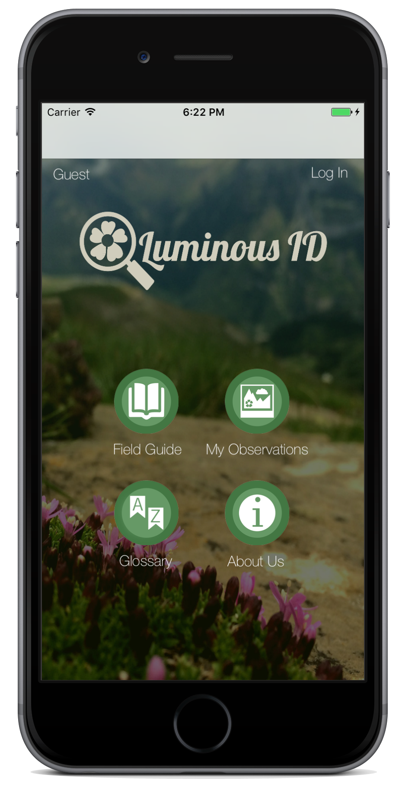
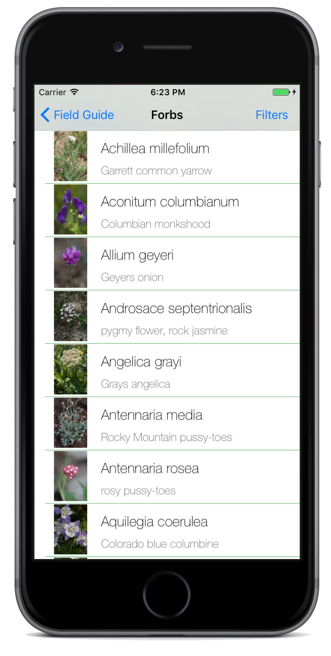
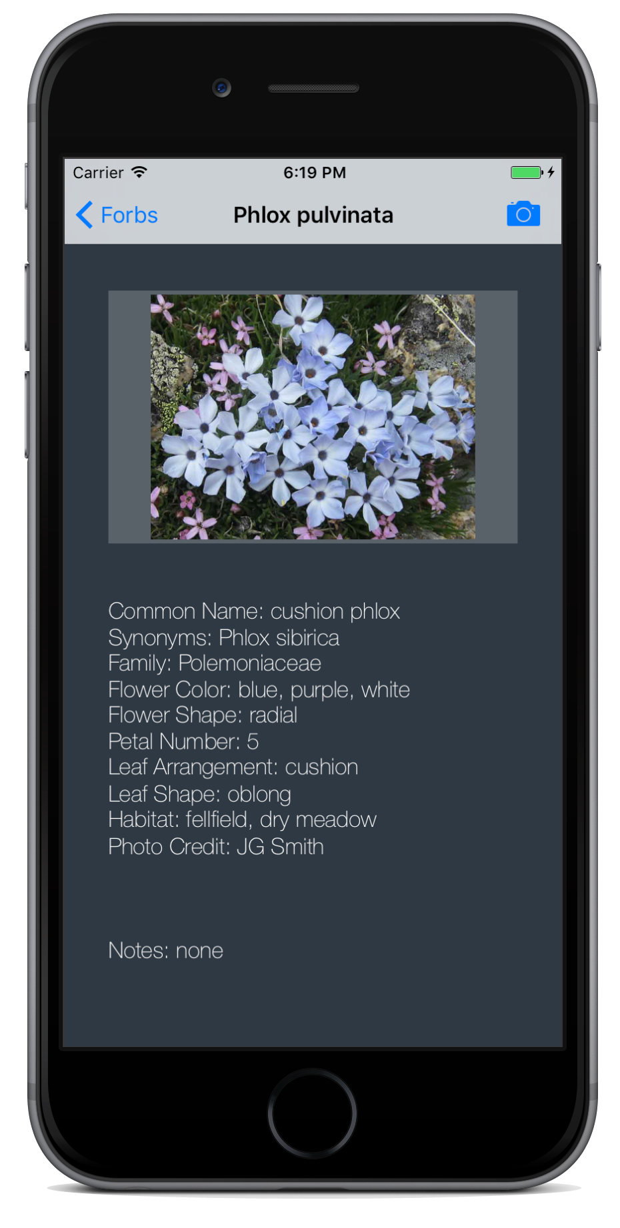
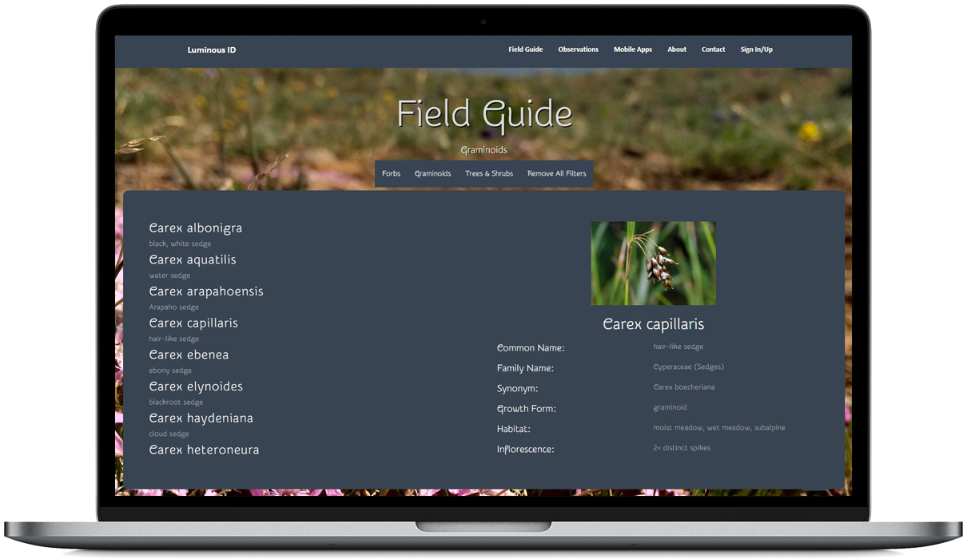









2016 - 2017
Ryan O’Connell, Chase Springer, Brian Larson, D’Vreaux Fontaine, Jennifer Baumann, Kevin Rau
An Adventure Awaits!
Goals
Increase citizen engagement at the Long-Term Ecological Research site on Niwot Ridge. Create a geographic and photographic dataset of plant species for climate change research.
Objective
Create a mobile application software and website to allow visitors to search for and add observations of plant species in the Niwot Ridge area.
Challenges
The development of the database was the largest roadblock to overcome. After creating the schemas, we then had to find a backend tool to help build the database.
Mobile Applications
Website
Tools
luminousid.org
Sponsors
Nathalie Chardon, Jane Smith

